Slide 1
EPOC432
Principles of Communication
4th Semester B. Tech. (IT)
Teachers:
Dr. Neetesh Purohit
Dr. Pooja Mishra

Slide 2
Text book and Grading
“Communication Systems”, A. B. Carlson, McGraw Hills.
Grading will be done out of 150 Marks:
  Midsem (30)
  Endsem (75)
  Internal Assessment (45)
    2 or 3 class tests (30)
    Interaction during Class/Viva (15)
Registration in this subject will be automatically cancelled for those who fail to attend at least 75% classes.

Slide 3
Electrical Communication system
Message (Physical manifestation of INFORMATION) Message
I/P Transducer
O/P Transducer
Electrical signal
Transmitter
Receiver
channel
Twisted Copper wire coaxial cable
optical fiber space

Slide 4
Unit - I
Fundamentals of Continuous Time Signals and Systems

Slide 5
Representation of a Sinusoid
Time Domain (magnitude Vs time) x(t)=A.COS(ωt+φ)
Phasor Diagram {x(t) = Re [A e^{jφ} e^{jωt}]}
  (x axis-Re part, y axis – Im part, an anticlockwise rotating phasor of length = Amplitude and initial point (t=0) at an angle = phase)
  Two half length phasors rotating in opposite directions [Re(Z)=1/2(z+z*)]
Line spectrum (Amp Vs Freq and Phase Vs Freq)
  One sides or two sided.

Slide 6
Conventions of a Line Spectrum
X-axis shows cyclic frequency (f) in hertz (not the radian frequency (ω) ).
Phase angles should be measured with respect to cosine wave.
Amplitude should always be a +ve quantity the -ve sign (if appeared) should be appropriately compensated in phase spectrum
Amplitude spectrum is symmetric and the phase spectrum is anti symmetric.

Slide 7
Draw the line spectrum
X(t)= 7 – 10cos(40πt - 60) + 4sin(120πt)

Slide 8
Fourier Tools
Fourier Series (for power signals)
Fourier Transform (for energy signals)
Short time Fourier Transform
Discrete Fourier Transform/ Fast Fourier Transform

Slide 9
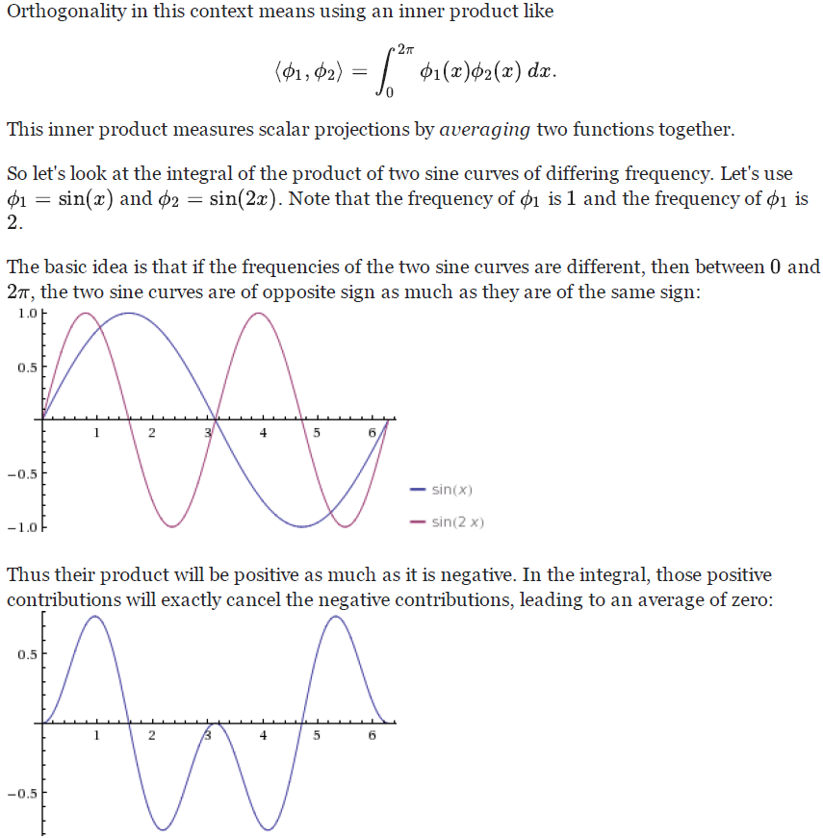


Fourier Series
Baron Jean Baptiste Joseph Fourier (1768 − 1830) introduced the idea that any periodic function can be represented by a series of sines and cosines which are harmonically related.
http://math.stackexchange.com/questions/474398/waves-of-differing-frequency-are-orthogonal-help-me-understand

Slide 10
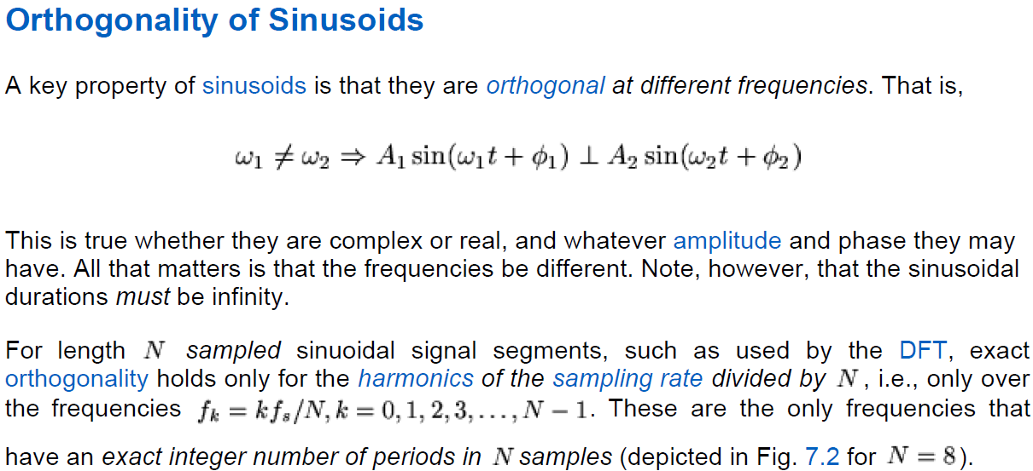
http://www.technick.net/public/code/cp_dpage.php?aiocp_dp=guide_dft_orthogonality_sinusoids

Slide 11
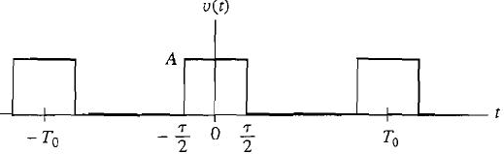
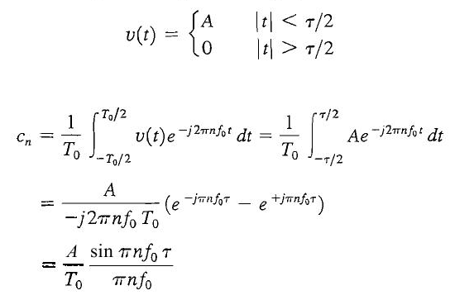
Spectrum of rectangular pulse train with ƒ₀τ = 1/4

Slide 12
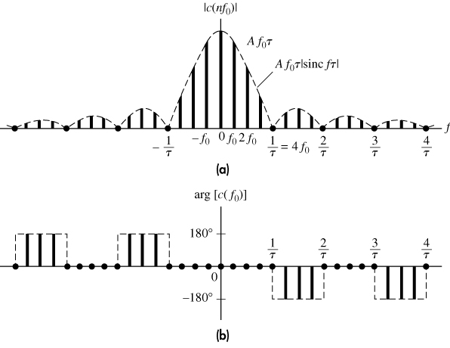
Continue...
It is an even function of λ having its peak (= amplitude) at λ=0 and zero crossing at all other integer values of λ.
Main lobe contains appx 90% of total area and peaks of side lobes gradually decreases to zero at infinity
Sinc λ = [sin(πλ)]/πλ
How many lines exists in any lobe of a given rectangular pulse train?
2. Should it be + OR – 180 in phase?

Slide 13
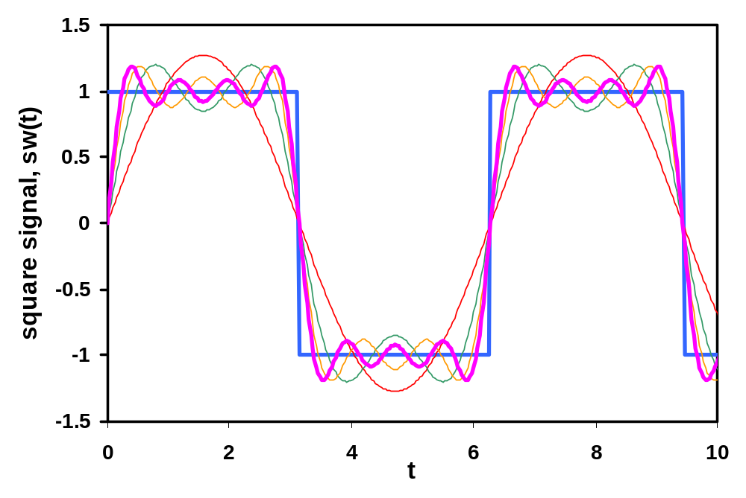
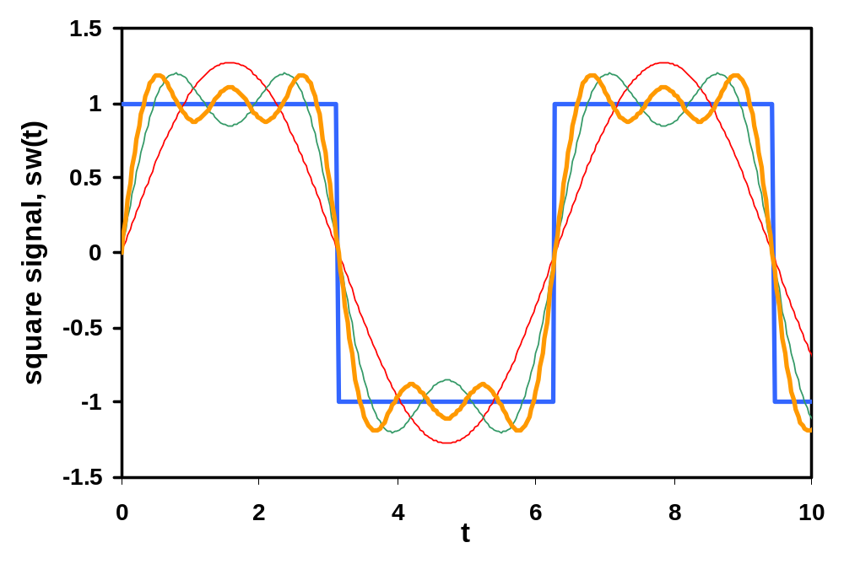
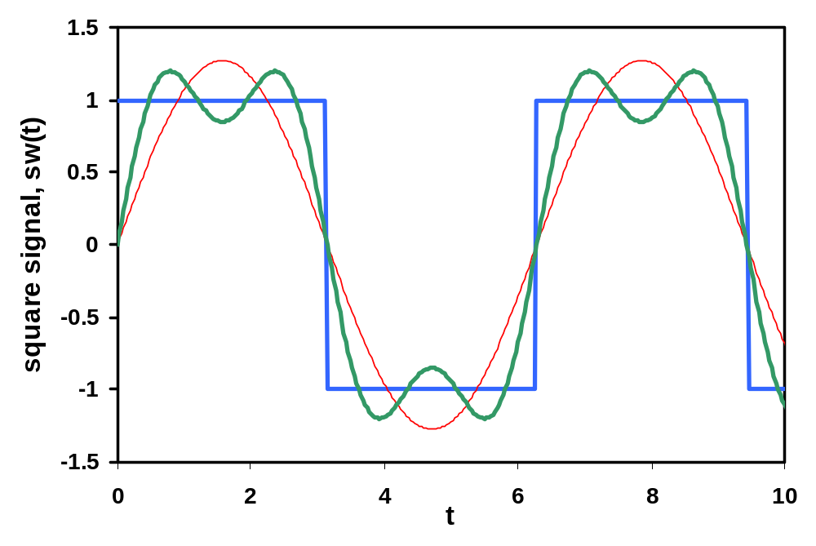
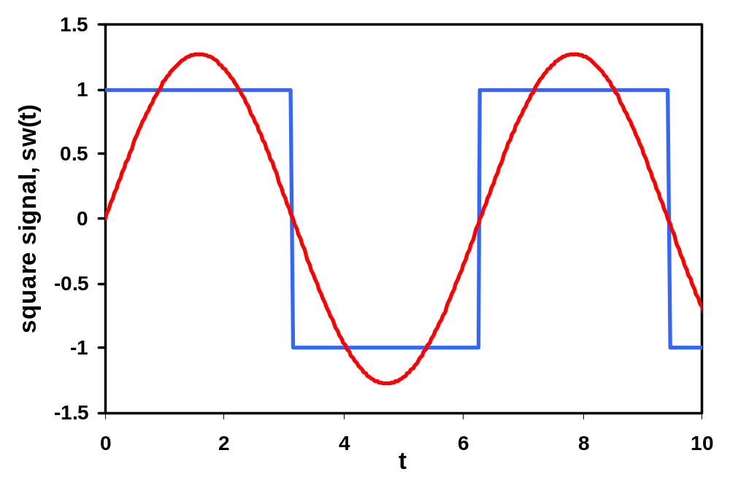
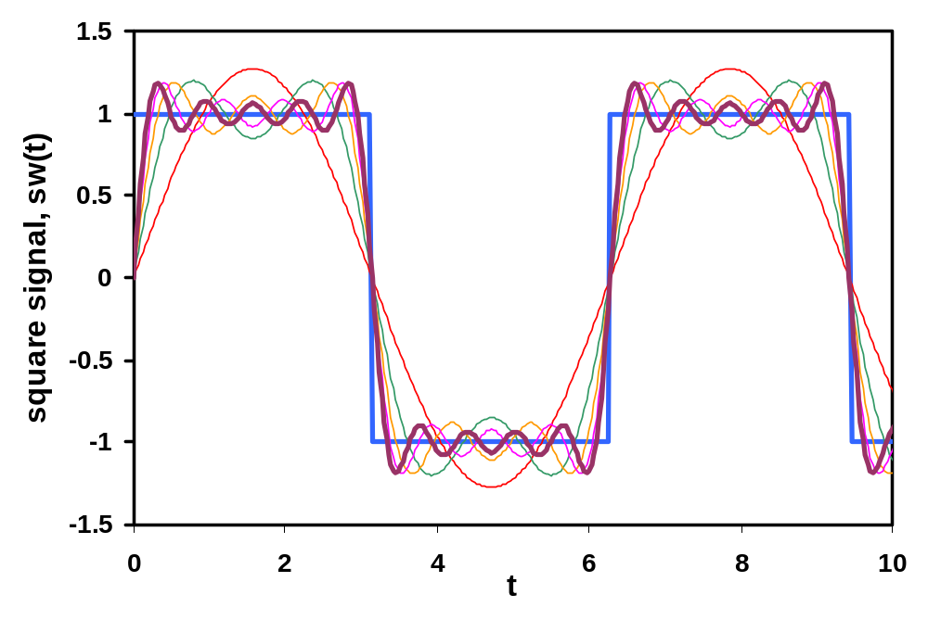
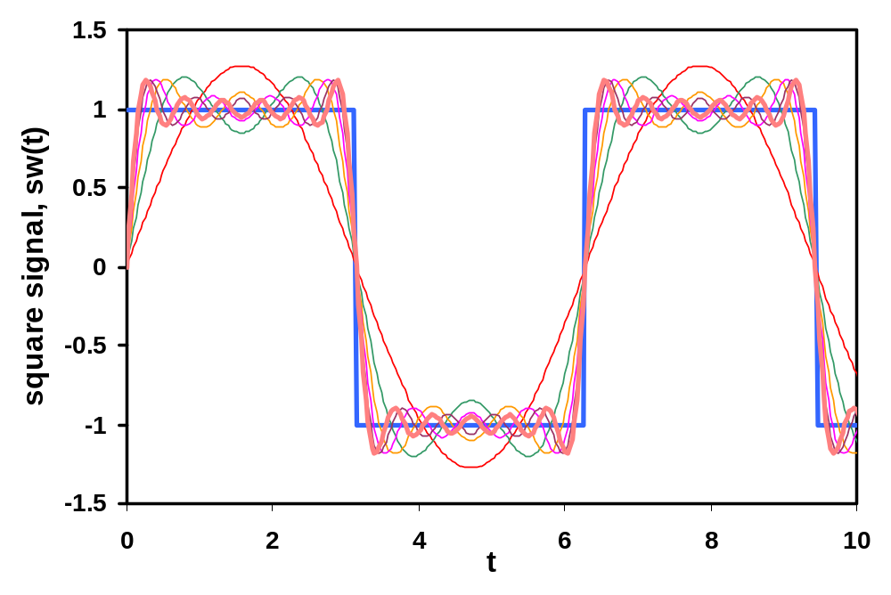
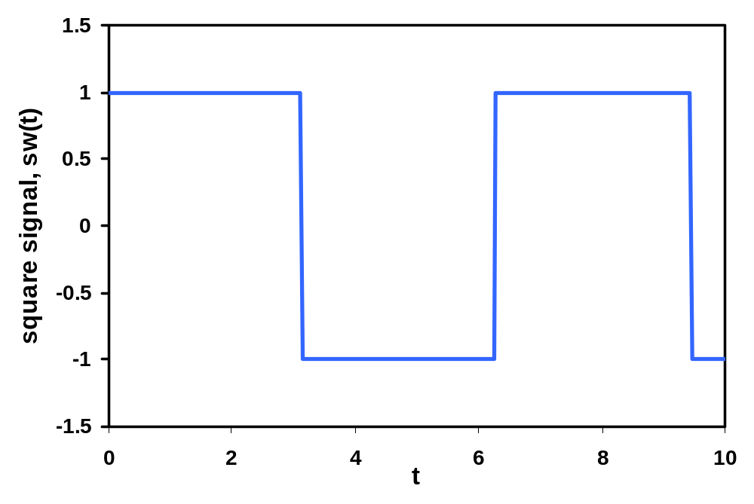
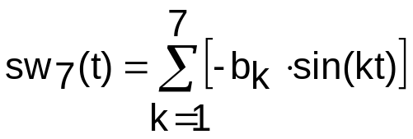
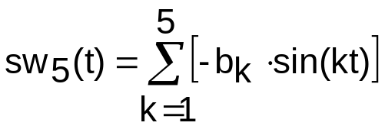

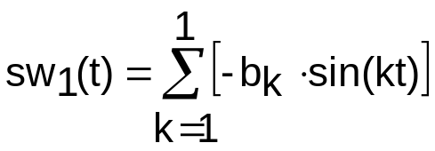
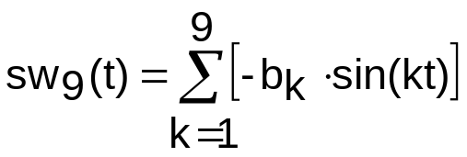
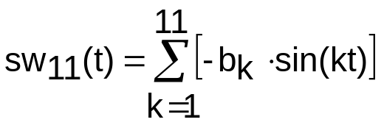
FS synthesis
Square wave reconstruction from spectral terms
Convergence may be slow (~1/k) - ideally need infinite terms.
Practically, series truncated when remainder below computer tolerance
(⇒ error). BUT … Gibbs’ Phenomenon.

Slide 14
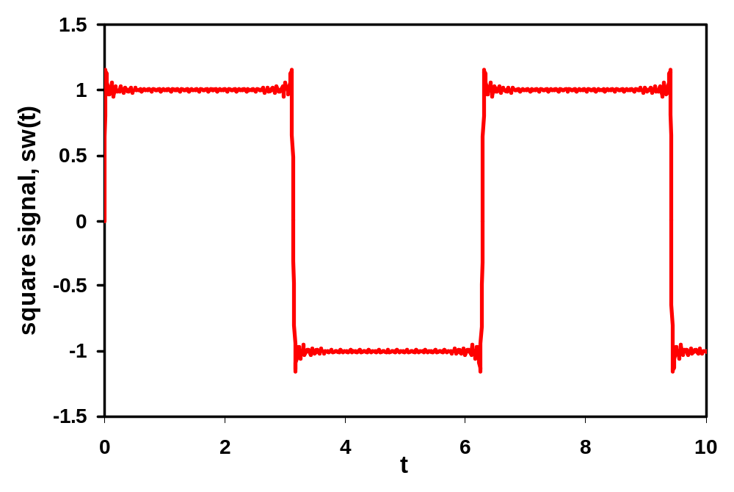
Gibbs phenomenon
Overshoot exist @ each discontinuity
  First observed by Michelson, 1898. Explained by Gibbs.
  Max overshoot pk-to-pk = 8.95% of discontinuity magnitude.
  Just a minor annoyance.
  FS converges to (-1+1)/2 = 0 @ discontinuities, in this case.

Slide 15
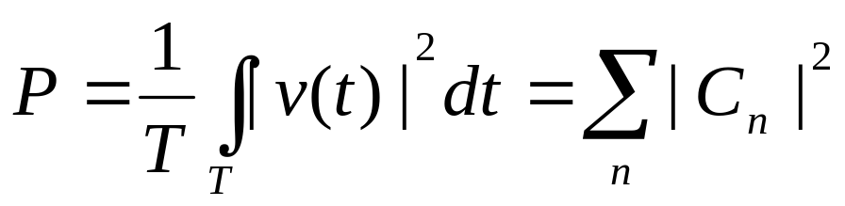
Parseval’s Power theorem
Total avg power of v(t) is the sum of the avg power of its phasor components.
It can be proved using Fourier series analysis and synthesis formulae.

Slide 16
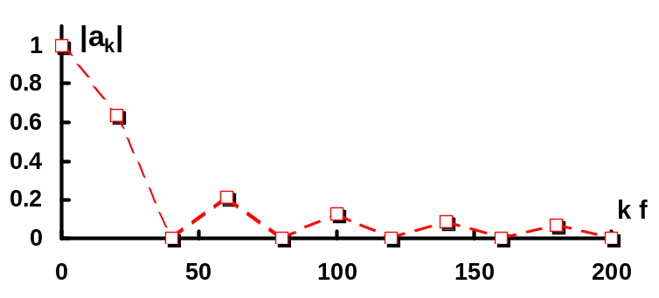
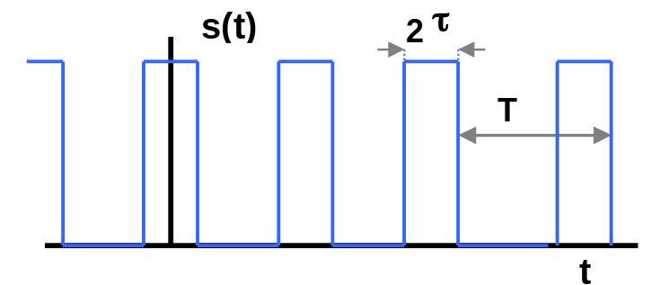
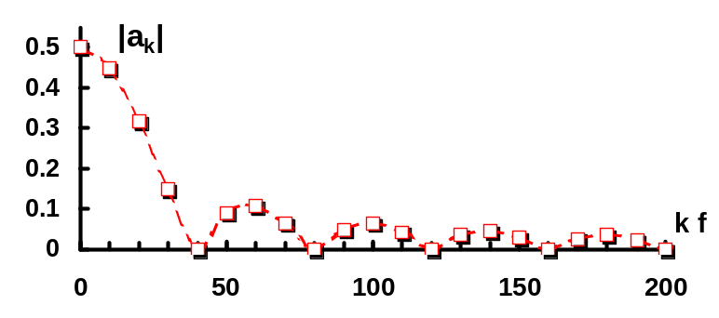
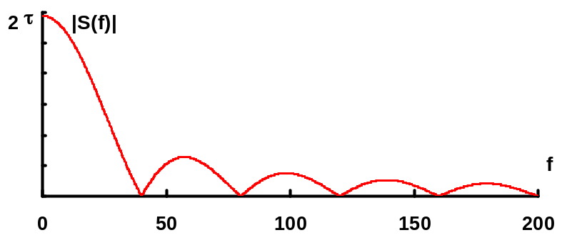
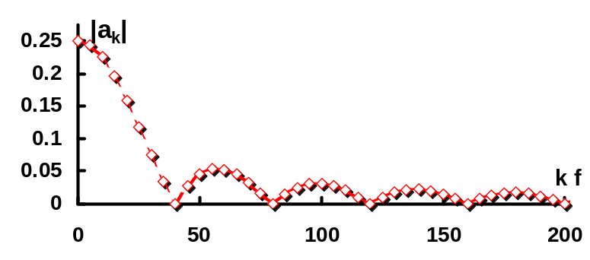
From FS to FT
FS moves to FT as period T increases: continuous spectrum
T = 0.05
T = 0.1
Pulse train, width 2 τ = 0.025
Frequency spacing →0 !
FT
T = 0.2
Note: |a_{k}|→2 a₀ as k→0 ⇒ 2 a₀ is plotted at k=0

Slide 17
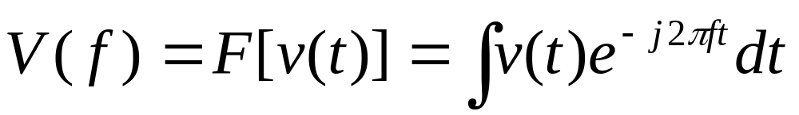
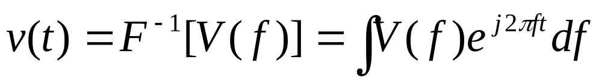
Fourier Transform
Spectrum of rectangular pulse and reciprocal spreading.
Even and odd parts of V(f).
Theorems: Rayleigh’s, Duality, Time-frequency relations, frequency translation, Differentiation, Integration, Convolution etc

Slide 18
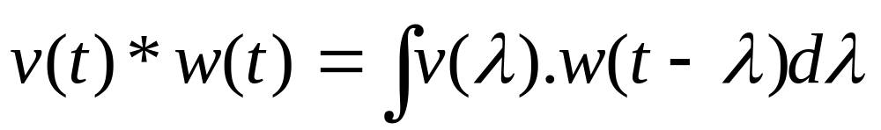
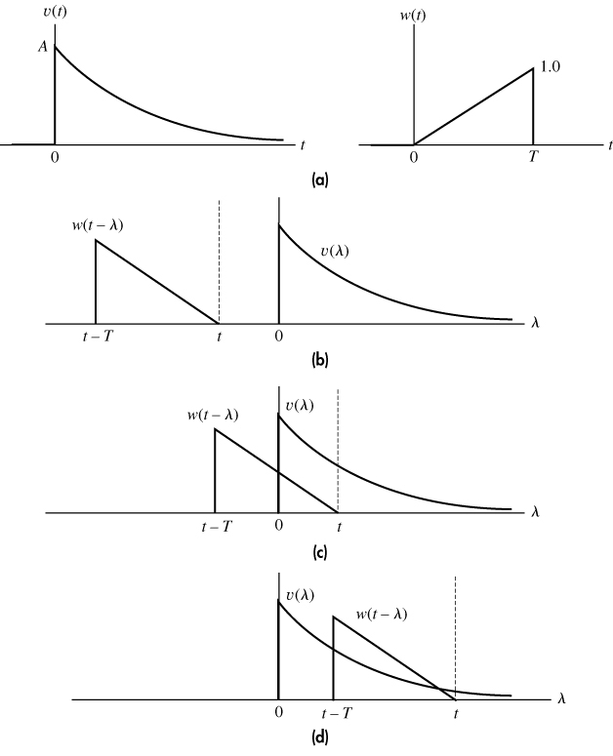





Convolution

Slide 19
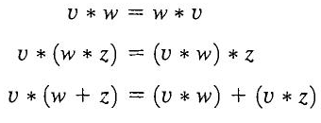

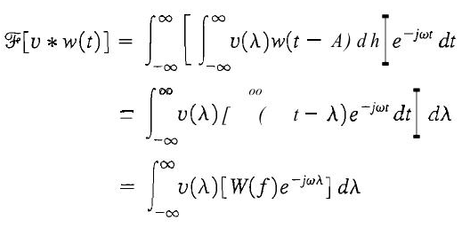

Properties and convolution theorem

Slide 20
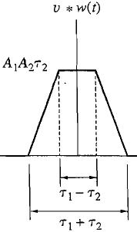
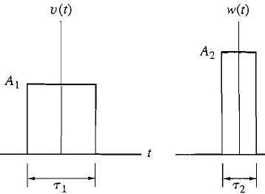

Slide 21
Impulse Function
δ(t) represents a unit area concentrated at a point t=0.
A.δ(t-td) represents an area = A, concentrated at a point t-td=0 i.e. t=td.
Integration operation has been implicitly considered in defining δ(t). In other words, there is no physical or mathematical significance of δ(t) if it is treated as an ordinary function.

Slide 22
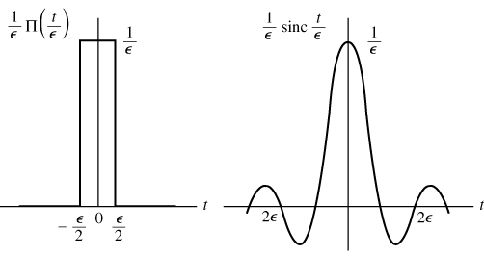

δ(at)= (1/|a|) δ(t)
δ(t-td).v(t)= δ(t-td).v(td)
δ(t)*v(t) = v(t)

Slide 23
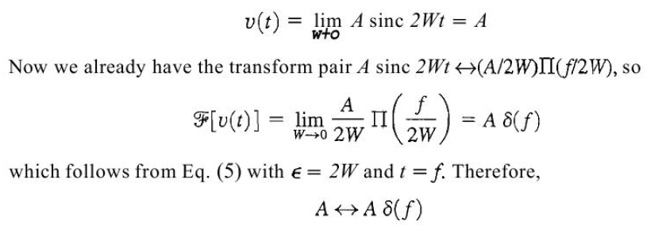





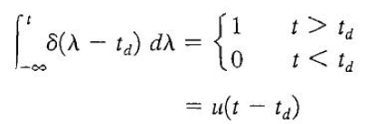

Applications of Impulse Function

Slide 24
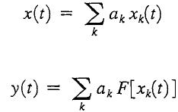

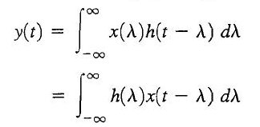
Linear Timeinvariant systems
Linearity Condition
Time invariant property
Impulse response and role of convolution
δ(t-td).v(t)= δ(t-td).v(td)
δ(t)*v(t) = v(t)

Slide 25
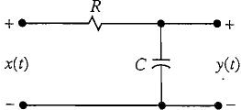


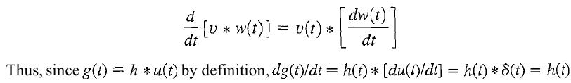
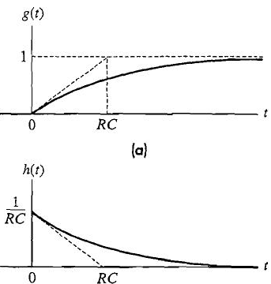
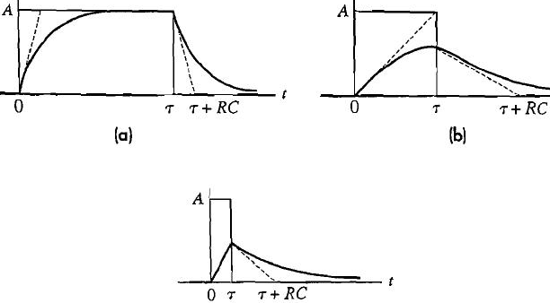

Time Response of First Order Systems

Slide 26
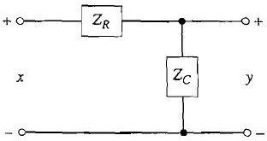
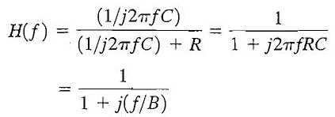

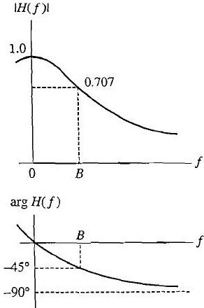

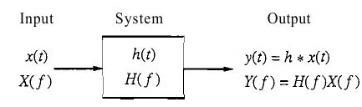
Frequency Response of 1st Order System

Slide 27
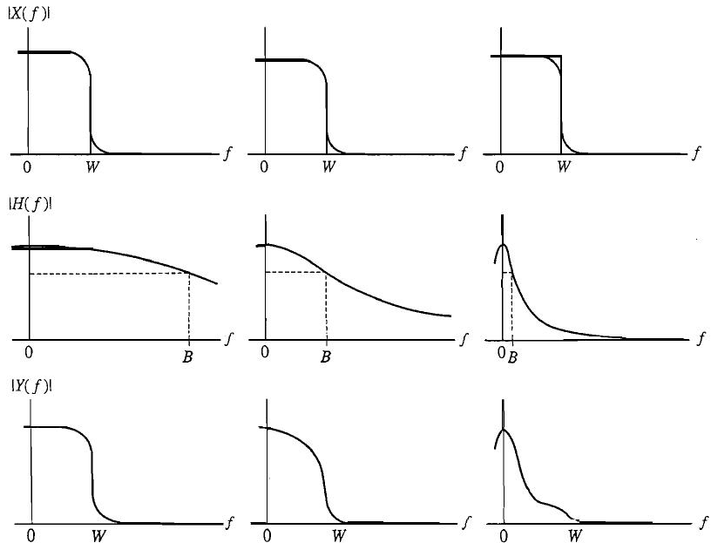

Slide 28
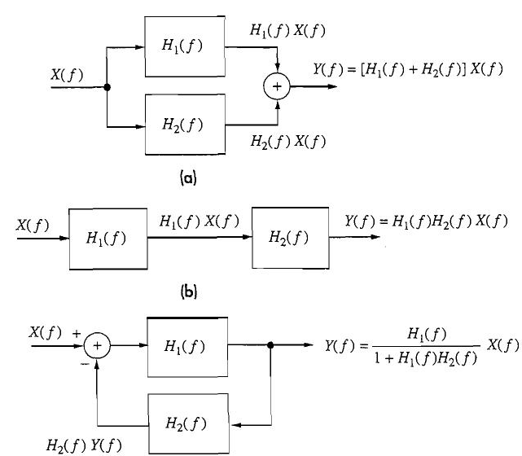
Interconnection properties of LTI systems

Slide 29


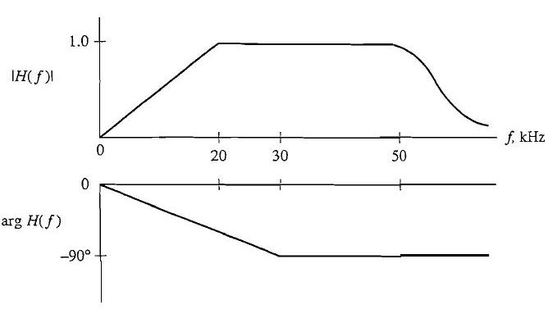
Distortionless Transmission

Slide 30
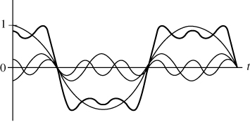
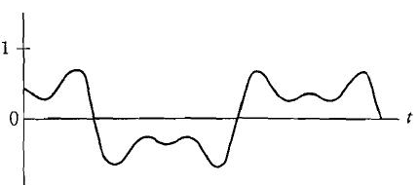



Amplitude Distortion
Test signal x(t) = cos ω₀t - 1/3 cos 3ω₀t + 1/5 cos 5ω₀t
(greater distortion in shape but sharp)
(reduces sharpness but little distortion in shape)
Copyright © The McGraw-Hill Companies, Inc. Permission required for reproduction or display.

Slide 31

Copyright © The McGraw-Hill Companies, Inc. Permission required for reproduction or display.
Delay Distortion:
Constant time delay is desired as all harmonics are getting delayed by same amount of time
Constant phase delay (θ) produces distortion as each harmonic will delay by θ/2π cycles of its own frequency.
Human ears are insensitive to phase distortion.
Notes:
Shape of Waveform has been altered but still it has all frequency components in same proportion thus it will produce similar sound

Slide 32



Nonlinear Distortion
find Y(f)??

Slide 33




Slide 34






Ideal and Practical Filters
Ideal filters are unrealizable??

Slide 35



Pulse response and rise time
Step response of ideal LPF, g(t) = ½ + 1/π. Si (2πBt)
10-90% risetime (tr) = 1/2B
Pulse response = g(t) – g(t- τ)
For pulse detection Bτ >= ½

Slide 36






Scalar product: a measure of similarity

Slide 37
Continue..
V(t)
V(t)
V(t)
w(t)
w(t)
w(t)
More +ve scalar product shows more similarity. Max value when v(t) = w(t)
Zero scalar product shows NO similarity
More -ve scalar product shows more similarity with opposite polarity. Max value when v(t) = - w(t)
Notes:
Single period is considered for the analysis of periodic signals

Slide 38
Correlation Functions
Rvw(τ) = <v(t).w*(t- τ)> = <v(t+τ).w*(t)>
Rvw(τ) = R*wv(-τ)
Autocorrelation Rvv(τ) = Rv(τ)
= <v(t).v*(t- τ)> = <v(t+τ).v*(t)>
Rv(0)= Pv and |Rv(τ)| <= Rv(0)
Find autocorrelation of z(t)= A cos (ωt+φ)

Slide 39






Energy Signals Correlation

Slide 40







τ- domain analysis of LTI systems

Slide 41








Spectral Density

Slide 42









Representation of signals as vectors
Norm as a measure of length
Correlation as a measure of angle
(v,w)=0 for uncorrelated signals thus Pythagoras theorem holds indicating orthogonal relation between v and w.
Schwarz inequality says (v,w)=||v||.||w|| for proportional signal
Define the components using unit vector

Slide 43
Gram-Schmidt Procedure
Select from signal set any s1(t) having nonzero norm and find φ1=s1/||s1||
Select another signal s2(t). Compute the coordinate α21=(s2, φ1) and define auxiliary vector g2=s2- α21.φ1. Find φ2=g2/||g2||
Select another signal s3(t). Compute coordinates α31 and α32 to define g3= s3 – [φ1.α31+φ2.α32]. Find φ3=g3/||g3||
Continue in this manner until all M signals have been considered.

Slide 44




